Slide 1
1st International Conference on Futuristic Aspects in Science & Engineering (ICFAiSE-2025)
06 - 07 February 2025
Paper ID: 259
Diabetes Detection using Machine Learning Algorithms
Abhinav Kumar Choudhary
Undergraduate Student
School of Computer Science and Engineering
Galgotias University
Greater Noida, Uttar Pradesh, India
kumarabhi5g@gmail.com
Kanika Yadav
Undergraduate Student
School of Computer Science and Engineering
Galgotias University
Greater Noida, Uttar Pradesh, India
yadavkanika308@gmail.com
Yashwant Soni
Assistant Professor
School of Computer Science and Engineering
Galgotias University
Greater Noida, Uttar Pradesh, India
yashwant.soni@galgotiasuniversity.edu.in
Vikash Kumar Mishra
Assistant Professor
School of Computer Science and Engineering
Galgotias University
Greater Noida, Uttar Pradesh, India
mail2dr.vikash@gmail.com

Slide 2
Contents
Abstract
Introduction
Objectives
Methodology
Result and Discussions
Conclusion
References

Slide 3
Abstract
Diabetes is a metabolic disorder that affects the body's ability to regulate blood sugar levels.
Diabetes affects millions worldwide, with 537 million cases reported in 2021 and predictions of 783 million by 2045. In order to reduce risk to health, early identification is essential.
Develop a machine learning model for accurate diabetes prediction using key health factors like glucose, BMI, age, and family history.
Machine learning classification algorithms namely Logistic Regression, Random Forest, Decision tree, LightGBM, XGBoost, CART, KNN and SVM are used in this experiment.
XGBoost achieved the highest accuracy (89%), followed by Random Forest and LightGBM (88%).
Machine learning algorithms improve early detection, providing healthcare professionals with a more cost-effective and efficient solution

Slide 4
Introduction
Diabetes is a fast-growing global health issue affecting people of all ages.
The body struggles to use insulin properly or produce enough insulin, causing high blood sugar levels.
According to the data of International Diabetes Federation approximately 537 million adults (20-79 years) are living with diabetes. The total number of people living with diabetes is projected to rise to 643 million by 2030 and 783 million by 2045.
Various symptoms of diabetes are excessive hunger, thirst, frequent urination, weight loss, fatigue, blurred vision.
Untreated diabetes can lead to severe complications like heart disease, kidney failure, and blindness.

Slide 5
The types of Diabetes are:
Type 1 diabetes means that the immune system is compromised, and the cells fail to produce insulin in sufficient amounts.
Type 2 diabetes means that the cells produce a low quantity of insulin, or the body can’t use the insulin correctly.
Type 3- Gestational diabetes is a type of diabetes that develops during pregnancy. Gestational diabetes is usually diagnosed in the 24th to 28th week of pregnancy.

Slide 6
Objective
To predict whether a person is diabetic or not at an early stage.
To understand and analyze the present diabetics diseases.
To evaluate the performance of the proposed model for clinical relevance.
To handle imbalanced datasets (more non-diabetic than diabetic cases).
To ensure the model generalizes well to unseen data.

Slide 7
Methodology
Various Steps involved are :
Data Collection: Gather and understand data to identify patterns for prediction and evaluation.
Data Preparation: Preprocess data to handle missing values and impurities, enhancing data quality for analysis.
Feature Selection: Identify key features for diabetes prediction (e.g., glucose levels, BMI, age).
Model Building: Apply machine learning techniques to analyze performance and determine accuracy after data preparation.
Training and Test Phase: Split the dataset into training and test sets; train the ML model using the training data.
Performance Evaluation: Use confusion matrix and metrics (accuracy, precision, F1-score) to assess model predictions and effectiveness.

Slide 8
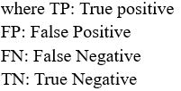


Accuracy Classification accuracy is what we usually mean, when we use the term accuracy. It is the ratio of number of correct prediction to the total number of input samples.
Precision It is implied as the measure of correctly identified positive case(Tp) from all the predictive positive cases(Tp + Fp).
Recall/Sensitivity It is implied as the measure of correctly identified positive case(Tp) from all the actual positive cases.
F1-Score It is harmonic mean of precision and recall. It gives the better measure of incorrectly classified cases than the accuracy metric.

Slide 9
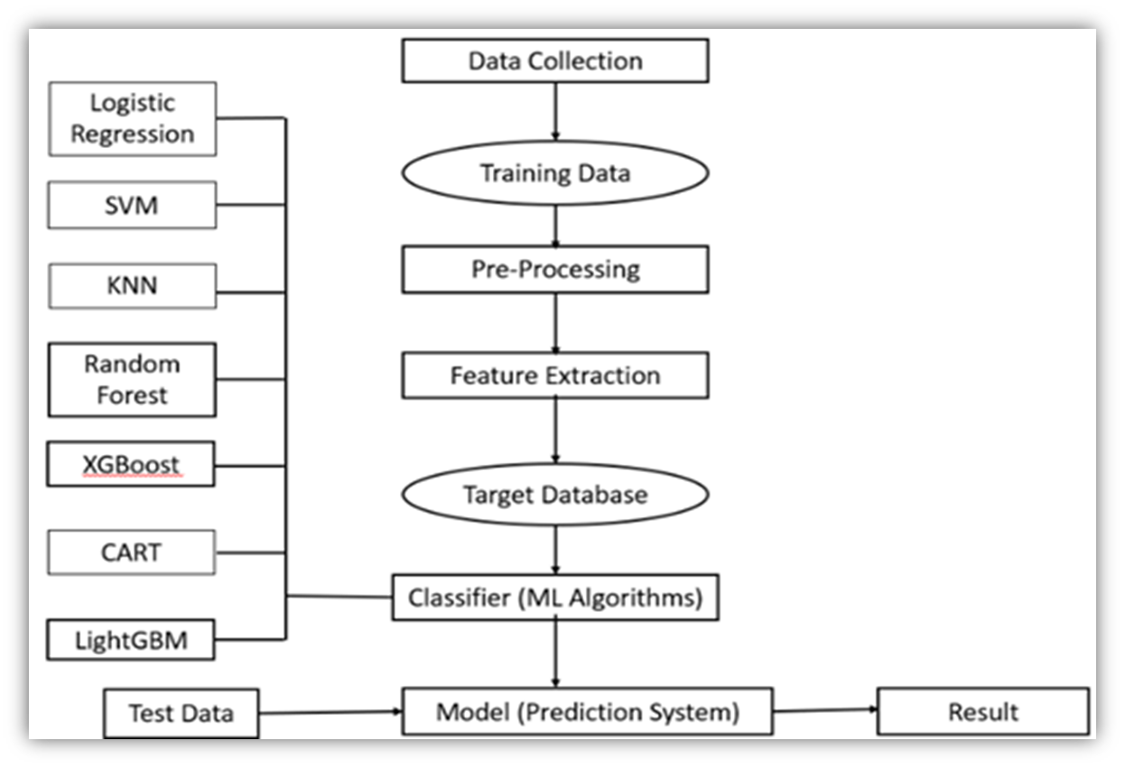
Fig. 1: Diabetes Flow Diagram

Slide 10
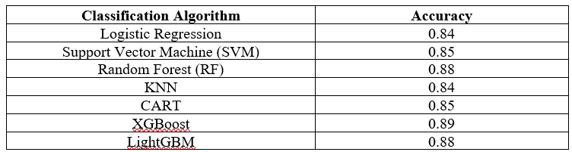
Result and Discussion
XGBoost achieved the highest accuracy of 89%, followed by Random Forest (88%) and LightGBM (88%).
Logistic Regression, KNN, and CART performed moderately with accuracy around 84-85%.
XGBoost outperformed other algorithms in diabetes prediction with the highest accuracy.
Early detection using machine learning models can help reduce complications and manage diabetes better.
Data privacy, generalization across diverse populations, and reliance on clinical data for accurate predictions.
Figure shows the result (Accuracy) of these Machine Learning methods:

Slide 11
Conclusion
Machine learning models such as XGBoost, Random Forest, and SVM show high accuracy in predicting diabetes.
Machine learning enables early identification of at-risk individuals, leading to preventive measures and reduced risk of complications.
XGBoost provides the most accurate results for diabetes detection, followed by Random Forest and LightGBM.
Machine learning models support faster, more accurate diagnoses, benefiting healthcare professionals and patients.
These models offer a cost-effective approach to diabetes screening and risk assessment, reducing the burden on healthcare systems.
Machine learning can be integrated with wearables and mobile apps for continuous diabetes monitoring and management.
Further improvements in models with lifestyle data and real-time processing will enhance prediction accuracy and personalized healthcare.

Slide 12
References
[1] Ahmed, "Prediction of diabetics empowered with fused Machine Learning", 2022 International Research Journal of Modernization in Engineering Technology and Science, Student, Department Of Computer Engineering, Pune Institute Of Computer Technology, Pune, India.
[2] Jiajia Song, Chao Wang, and Wenzhuo Zhao, “Literature review on machine learning for diabetes prediction”, 2021.
[3] B. V. Gowtham, "A Comprehensive Study on Predicting Diabetes Using Machine Learning Techniques", 2021.
[4] Soni, Yashwant, et al. "AM-UNet: Road Network Extraction from high-resolution Aerial Imagery Using Attention-Based Convolutional Neural Network." Journal of the Indian Society of Remote Sensing (2024): 1-13.

Slide 13
[5] Daliya, "An Optimized Multivariable Regression Model for Predictive Analysis of Diabetic Disease Progression", 2021 Department of Electronics and Communication Engineering, Amrita School of Engineering, Amrita Vishwa Vidyapeetham, Bengaluru, India.
[6] Yahyauoi, “Developing a decision support system for predicting diabetes using machine learning and deep learning techniques.”
[7] Deeraj Shetty, Kishor Rit, Sohail Shaikh, Nikita Patil, "Diabetes Disease Prediction Using Data Mining ". International Conference on Innovations in Information, Embedded and Communication Systems (ICIIECS), 2017.
[8] R. Raj, "Intelligent Diabetes Detection System using Machine Learning Techniques", 2020.
[9] S. T. Mir, "Diabetes Prediction using Machine Learning: A Review and Future Directions", 2021.
[10] S. S. Shetty, "A Comparative Analysis of Machine Learning Techniques for Predicting Diabetes", 2022.

Slide 14
Thank You

